Slide 1
Broadcast Intents and
Broadcast Receivers

Slide 2
Exercises
Create an app to broadcast a custom intent
Create an app to broadcast a system intent (AIRPLANE MODE CHANGED)

Slide 3
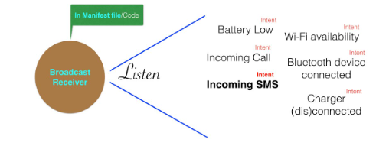
Broadcast Intents and Broadcast Receivers
A way to broadcast system wide messages to other components on the system.
Involves the implementation of Broadcast Intents and Broadcast Receivers

Slide 4
An Overview of Broadcast Intents
Broadcast intents are used by the Android system to notify interested applications about key system events.
Such as the external power supply or headphones being connected or disconnected.

Slide 5
An Overview of Broadcast Intents
The action string, which identifies the broadcast event, must be unique and typically uses the application’s package name syntax.

Slide 6
An Overview of Broadcast Intents
Intent intent = new Intent();
intent.setAction("com.example.Broadcast");
intent.putExtra("MyData", 1000);
sendBroadcast(intent);
Successfully launch the corresponding broadcast receiver on a device running an Android version earlier than 3.0.

Slide 7
An Overview of Broadcast Intents
On more recent versions of Android, the intent would not be received by the broadcast receiver.
  This is because Android 3.0 introduced a launch control security measure that prevents components of stopped applications from being launched via an intent.
  Stopped: application has either just been installed and not previously launched, or been manually stopped by the user using the application manager on the device.

Slide 8
An Overview of Broadcast Intents
A flag can be added to the intent before it is sent to indicate that the intent is to be allowed to start a component of a stopped application.
  FLAG_INCLUDE_STOPPED_PACKAGES
Intent intent = new Intent();
intent.addFlags(Intent.FLAG_INCLUDE_STOPPED_PACKAGES);
intent.setAction("com.example.Broadcast");
intent.putExtra("MyData", 1000);
sendBroadcast(intent);

Slide 9
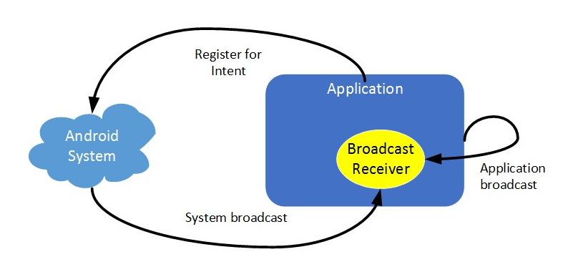
An Overview of Broadcast Intents

Slide 10
An Overview of Broadcast Receivers
An application listens for specific broadcast intents by registering a broadcast receiver.
Implemented by extending the Android BroadcastReceiver class and overriding the onReceive() method.
The broadcast receiver may then be registered,.
  Either within code (for example within an activity), or within a manifest file.
Registration implementation involves the creation of intent filters to indicate the specific broadcast intents the receiver is required to listen for.

Slide 11
An Overview of Broadcast Receivers
Achieved by referencing the action string of the broadcast intent.
When a matching broadcast is detected, the onReceive() method of the broadcast receiver is called.
  At which point the method has 5 seconds within which to perform any necessary tasks before returning.
In the event that a matching intent is detected, the Android runtime system will automatically start up the broadcast receiver before calling the onReceive() method.

Slide 12
An Overview of Broadcast Receivers
When registering a broadcast receiver within a manifest file, a <receiver> entry must be added for the receiver.

Slide 13
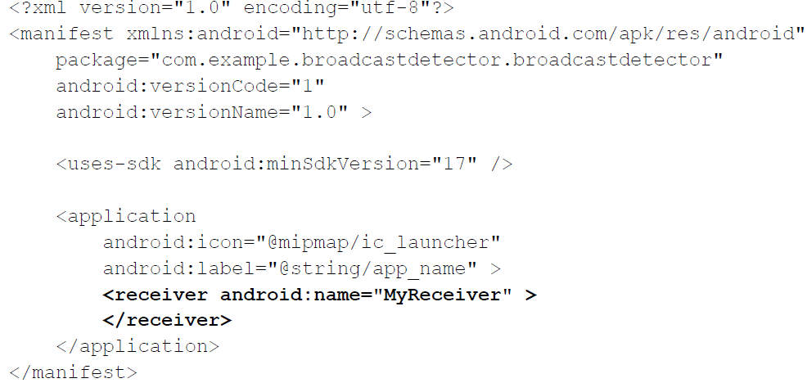
An Overview of Broadcast Receivers

Slide 14
An Overview of Broadcast Receivers
When running on versions of Android older than Android 8.0, the intent filters associated with a receiver can be placed within the receiver element of the manifest file as follows:
<receiver android:name="MyReceiver" >
<intent-filter>
<action android:name="com.example.Broadcast" >
</action>
</intent-filter>
</receiver>

Slide 15
An Overview of Broadcast Receivers
On Android 8.0 or later, the receiver must be registered in code using the registerReceiver() method of the Activity class together with an appropriately configured IntentFilter object:
IntentFilter filter = new IntentFilter("com.example.Broadcast");
MyReceiver receiver = new MyReceiver();
registerReceiver(receiver, filter);

Slide 16
An Overview of Broadcast Receivers
When a broadcast receiver registered in code is no longer required, it may be unregistered via a call to the unregisterReceiver() method of the activity class.
  Passing through a reference to the receiver object as an argument.
  For example, the following code will unregister the above broadcast receiver:
unregisterReceiver(receiver);

Slide 17
The Broadcast Intent Example
A simple application will be created for the purpose of issuing a custom broadcast intent.
A corresponding broadcast receiver will then be created that will display a message on the display of the Android device when the broadcast is detected.
Finally, the broadcast receiver will be modified to detect notification by the system that external power has been disconnected from the device.

Slide 18
Creating the Example Application
Launch Android Studio and create a new project.
Application name: SendBroadcast
Company Domain: ebookfrenzy.com
Click on the Next button.
Enable the Phone and Tablet option and set the minimum SDK setting to API 14: Android 4.0
Request the creation of an Empty Activity named SendBroadcastActivity with a corresponding layout resource file named activity_send_broadcast

Slide 19
Creating the Example Application
Locate and load the activity_send_broadcast.xml layout file located in the Project tool window under app -> res -> layout
Replace the TextView object with a Button view and set the text property so that it reads “Send Broadcast”.
Locate the onClick property in the Attributes panel and configure it to call a method named broadcastIntent

Slide 20
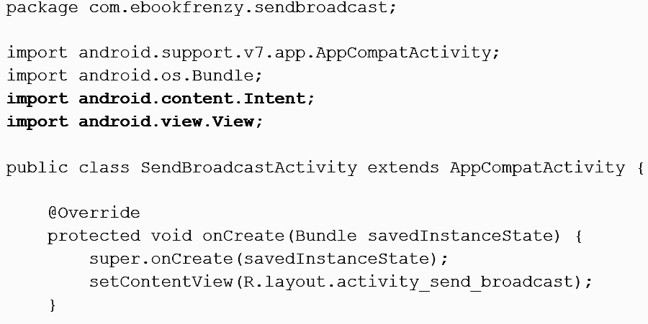
Creating and Sending the Broadcast Intent

Slide 21
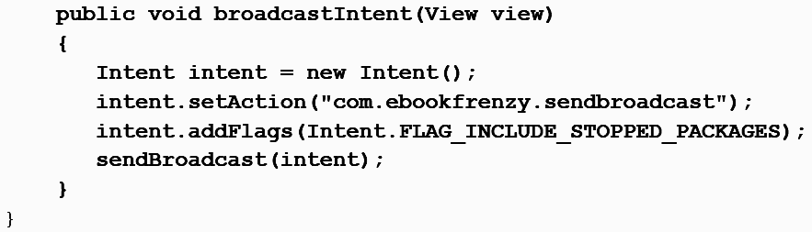
Creating and Sending the Broadcast Intent

Slide 22
Creating the Broadcast Receiver
In order to create the broadcast receiver, a new class needs to be created which subclasses the BroadcastReceiver superclass.
Within the Project tool window, navigate to app -> java and right-click on the package name.
From the resulting menu, select the New -> Other -> Broadcast Receiver menu option, name the class MyReceiver and make sure the Exported and Enabled options are selected.
These settings allow the Android system to launch the receiver when needed and ensure that the class can receive messages sent by other applications on the device.
With the class configured, click on Finish.

Slide 23
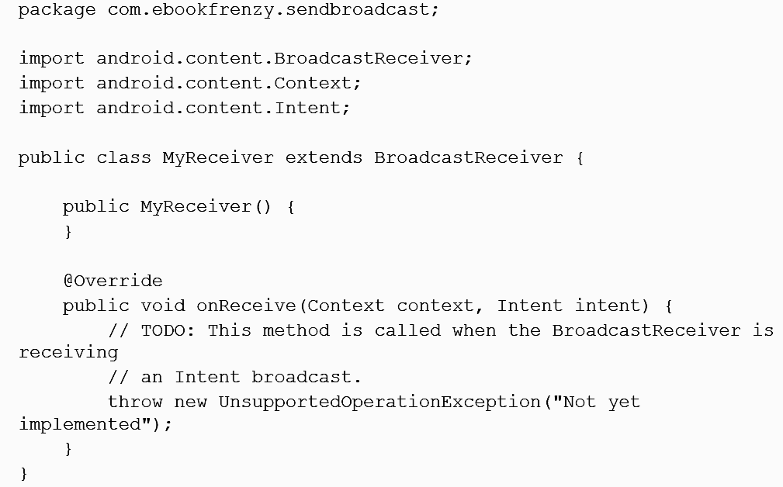
Creating the Broadcast Receiver

Slide 24
Creating the Broadcast Receiver
Android Studio has generated a template for the new class and generated a stub for the onReceive() method.
A number of changes now need to be made to the class to implement the required behavior.
Remaining in the MyReceiver.java file, therefore, modify the code so that it reads as follows:

Slide 25
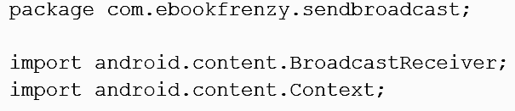
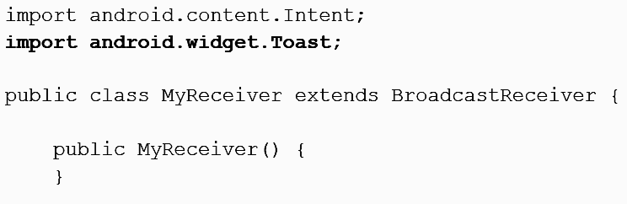
Creating the Broadcast Receiver

Slide 26
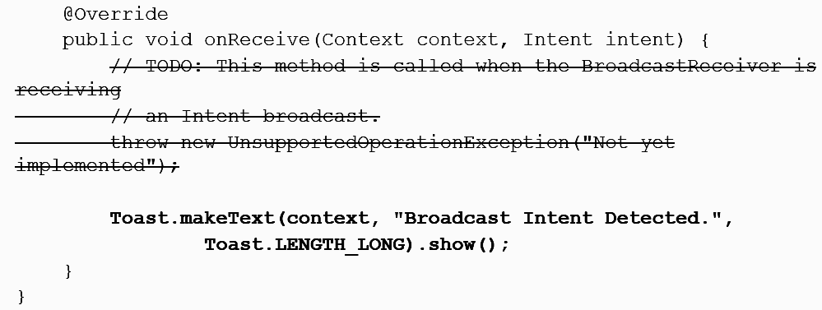
Creating the Broadcast Receiver

Slide 27
Registering the Broadcast Receiver
The file needs to publicize the presence of the broadcast receiver and must include an intent filter to specify the broadcast intents in which the receiver is interested.
When the BroadcastReceiver class was created in the previous section, Android Studio automatically added a <receiver> element to the manifest file.
All that remains, therefore, is to add code within the SendBroadcastActivity.java file to create an intent filter and to register the receiver:

Slide 28
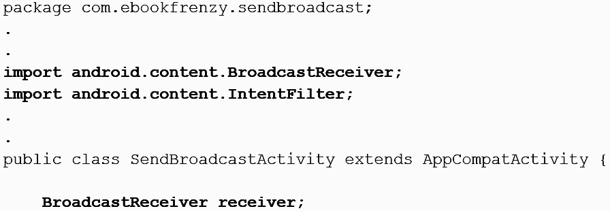
Registering the Broadcast Receiver

Slide 29
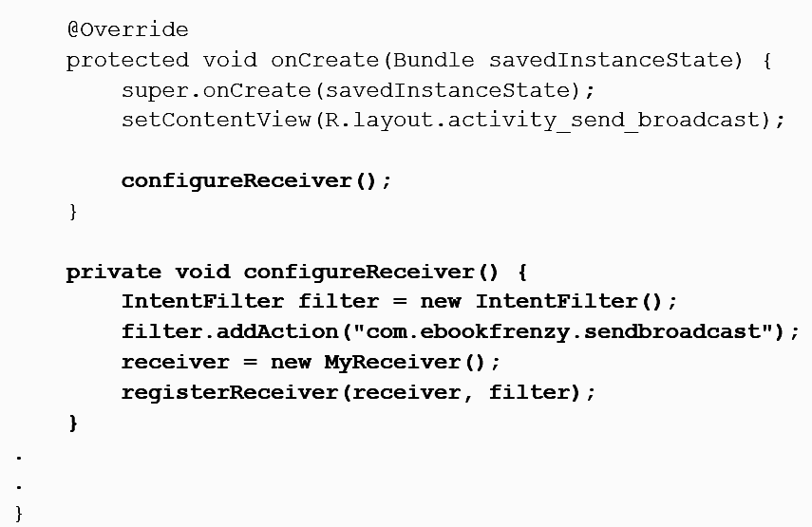
Registering the Broadcast Receiver

Slide 30
Registering the Broadcast Receiver
It is also important to unregister the broadcast receiver when it is no longer needed:
@Override
protected void onDestroy() {
super.onDestroy();
unregisterReceiver(receiver);
}

Slide 31
Testing the Broadcast Example
Run the SendBroadcast app on a device or AVD and wait for it to appear on the display.
Once running, touch the button, at which point the toast message reading “Broadcast Intent Detected.” should pop up for a few seconds before fading away.

Slide 32
Listening for System Broadcasts
The final stage of this example is to modify the intent filter for the broadcast receiver to listen also for the system intent that is broadcast when external power is disconnected from the device.
android.intent.action.ACTION_POWER_DISCONNECTED
Modify the onCreate() method in the SendBroadcastActivity.java file to add this additional filter:

Slide 33
Listening for System Broadcasts
private void configureReceiver() {
IntentFilter filter = new IntentFilter();
filter.addAction("com.ebookfrenzy.sendbroadcast");
filter.addAction("android.intent.action.ACTION_POWER_DISCONNECTED");
receiver = new MyReceiver();
registerReceiver(receiver, filter);
}

Slide 34
Listening for System Broadcasts
Since the onReceive() method is now going to be listening for two types of broadcast intent, modify the code so that the action string of the current intent is also displayed in the toast message.
This string can be obtained via a call to the getAction() method of the intent object passed as an argument to the onReceive() method:

Slide 35
Listening for System Broadcasts
public void onReceive(Context context, Intent intent) {
String message = "Broadcast intent detected " + intent.getAction();
Toast.makeText(context, message,Toast.LENGTH_LONG).show();
}
Test the receiver by re-installing the modified BroadcastReceiver package.
Touching the button in the SendBroadcast application should now result in a new message containing the custom action string:
Broadcast intent detected com.ebookfrenzy.sendbroadcast

Slide 36
Listening for System Broadcasts
Remove the USB connector that is currently supplying power to the Android device.
Broadcast intent detected android.intent.action.ACTION_POWER_DISCONNECTED

Slide 37
System Broadcast Intents - examples
https://developer.android.com/about/versions/11/reference/broadcast-intents-30

Slide 38
Thank You

